Slide 1

Genetic Algorithm

Slide 2
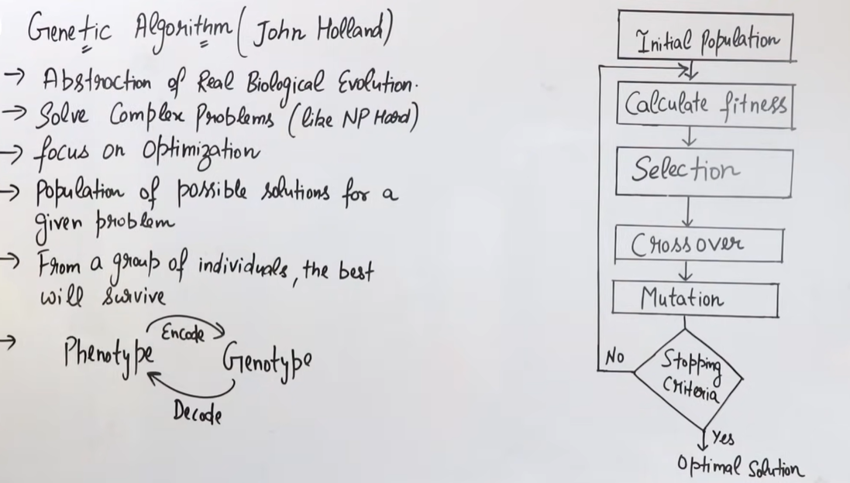

Slide 3
Local Search and GA
Local search methods involve making small changes to potential solutions to a problem until an optimal solution is identified.
Genetic Algorithm (GA) is a search-based optimization technique based on the principles of Natural Genetics and Natural Selection.
It finds the Optimal Solution based in survival of the fittest.
Optimization is the process of making something better i.e. to get the “best” output value.

Slide 4
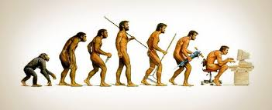
Evolutionary Computing
Natural systems as guiding metaphors
Charles Darwinian Evolution – 1859
Theory of natural selection
  It proposes that the plants and animals that exist today are the result of millions of years of adaptation to the demands of the environment
Over time, the entire population of the ecosystem is said to evolve to contain organisms that, on average, are ﬁtter for environment than those of previous generations of the population

Slide 5
Genetic Algorithms
The concepts of GAs are directly derived from natural evolution.
GAs emulate ideas from genetics and natural selection and can search potentially large spaces
Based on: survival of the most fittest individual
Two key steps: reproduction, survive

Slide 6
Genetic Algorithm
Based on Darwinian Paradigm
Intrinsically a robust search and optimization mechanism
Reproduction
Competition
Survive
Selection

Slide 7
Genetic Algorithm
The process for running a genetic algorithm is as follows.
  Generate a random population of chromosomes (this is the first generation).
  If termination criteria are satisfied, stop. Otherwise, continue with step 3.
  Determine the fitness of each chromosome.
  Apply crossover and mutation to selected chromosomes from the current generation to generate a new population of chromosomes—the next generation.
  Return to step 2.

Slide 8
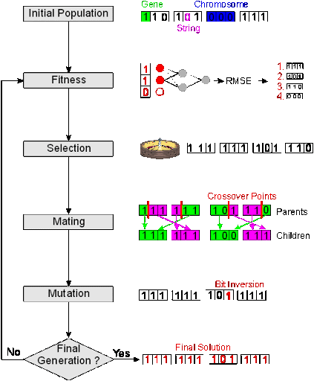

Slide 9
Genetic Algorithms
Before we can apply Genetic Algorithm to a problem, we need to answer:
  How can an individual be represented?
  What is the fitness function?
  How are individuals selected?
  How do individuals are generated?

Slide 10
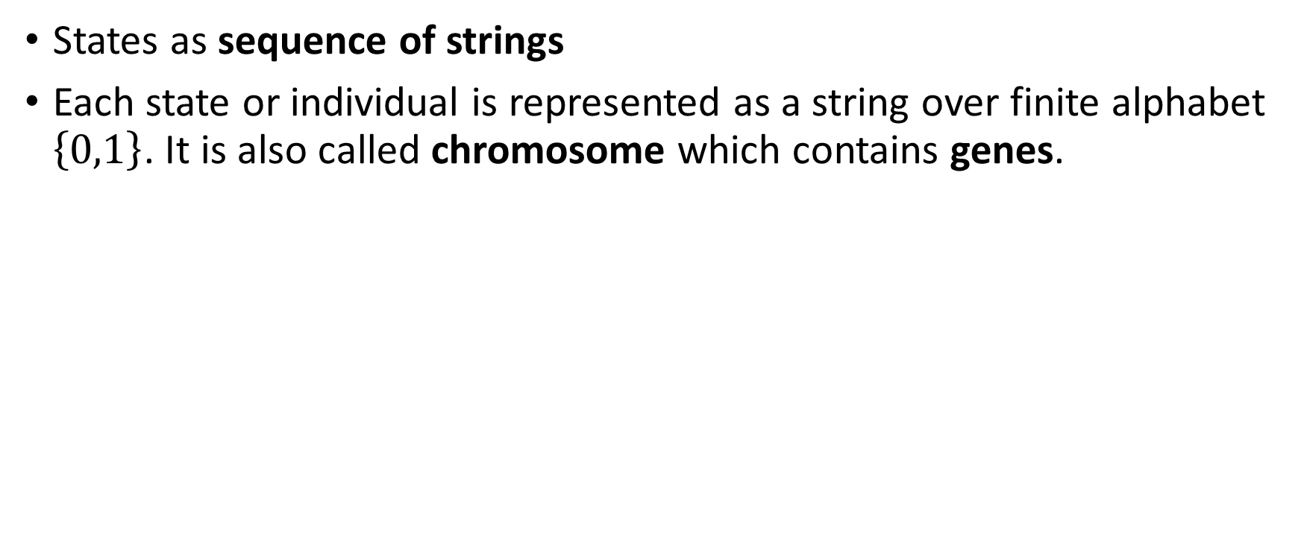
Representation of States (Solution)
States as sequence of strings
Each state or individual is represented as a string over finite alphabet $\left\{0,1\right\}$. It is also called chromosome which contains genes.
genes
1001011111
Solution: 607
Encoding
Chromosome: Binary String
Recall that every state is a solution in local search

Slide 11
Reproduction: Building New States
After representing States (Solutions).
Build a population of random solutions.
Let them reproduce using genetic operations.
  At each generation: apply ”survival of the fittest”
  Hopefully better and better solutions evolve over time
  The best solutions are more likely to survive and more likely to produce even better solutions

Slide 12
Evaluation and Selection
We then see how good the solutions are, using an evaluation function (recall f(n) in infomed search)
  Often it is a heuristic, especially if it is computationally expensive to do a complete evaluation
  The final population can then be evaluated more deeply to decide on the best solution

Slide 13
Survival of the Fittest
Select the surviving population
Likelihood of survival is related in some way to your score on the fitness function
  The most common technique is roulette wheel selection
Note we always keep the best solution so far
Remember: Its local search

Slide 14
Genetic Operators
These operators mimic what happens to our genetic material when we reproduce
  Crossover
  Mutation

Slide 15
Crossover Operator
Cut two solutions at a random point and switch the respective parts
Typically a value of 0.7 for crossover probability gives good results.
a₁
a₂
a₃
a₄
a₅
a₆
b₁
b₂
b₃
b₄
b₅
b₆


a₁
a₂
a₃
a₄
b₅
b₆
b₁
b₂
b₃
b₄
a₅
a₆

Slide 16
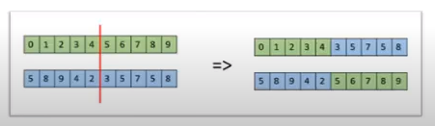
Crossover

Slide 17
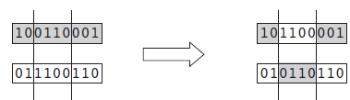
Crossover operator
The crossover operator is applied to two chromosomes of the same length as follows:
  1. Select a random crossover point.
  2. Break each chromosome into two parts, splitting at the crossover point.
  3. Recombine the broken chromosomes by combining the front of one with the back of the other, and vice versa, to produce two new chromosomes.
For example, consider the following two chromosomes:
  110100110001001
  010101000111101

Slide 18
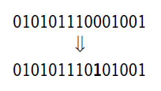
Mutation operator
Randomly change one bit in the solution
  Mutation is a unary operator (i.e., applied to just one argument—a single gene)
Occasional mutation makes the method much less sensitive to the original population and also allows ”new” solutions to emerge
a₁
a₂
a₃
a₄
a₅
a₆
Mutation of a2 = b1
a₁
b₁
a₃
a₄
a₅
a₆

Slide 19
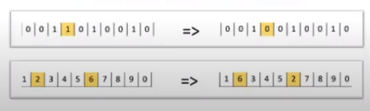
Mutation

Slide 20
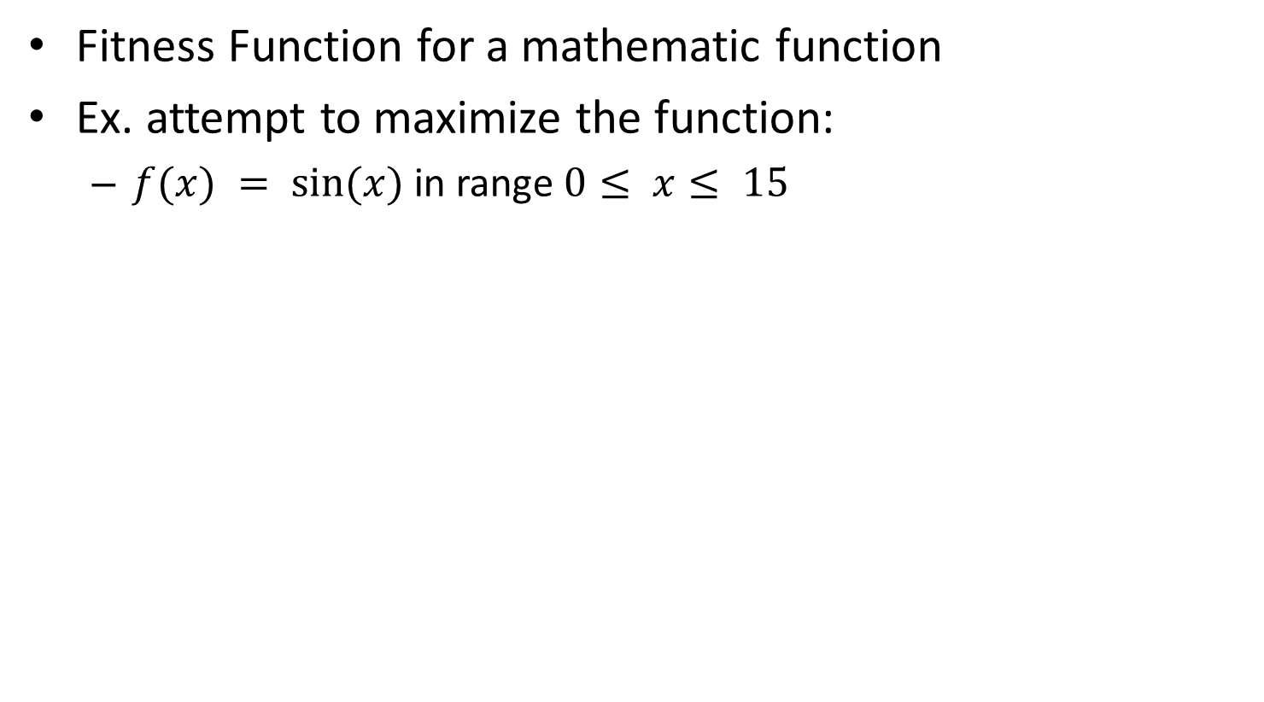
Fitness Function (Optimization)
Fitness Function for a mathematic function
Ex. attempt to maximize the function:
  $f(x) = sin⁡(x)$in range $0≤ x≤ 15$

Slide 21
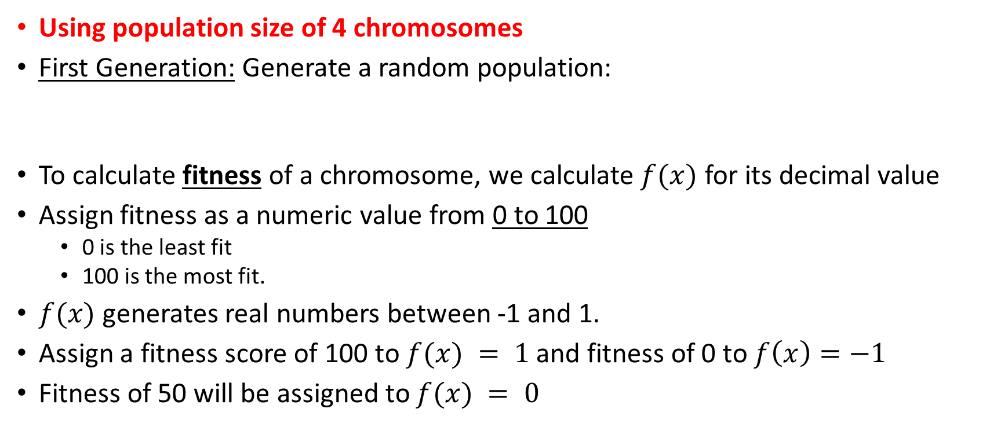
Fitness Function (Optimization)
Using population size of 4 chromosomes
First Generation: Generate a random population:
To calculate fitness of a chromosome, we calculate $f(x)$ for its decimal value
Assign fitness as a numeric value from 0 to 100
  0 is the least fit
  100 is the most fit.
$f(x)$ generates real numbers between -1 and 1.
Assign a fitness score of 100 to $f(x) = 1$ and fitness of 0 to $f\left(x\right)=−1$
Fitness of 50 will be assigned to $f(x) = 0$
c1 = 1001 (9) c2 = 0011 (3) | c3 = 1010 (10) c4 = 0101 (5)

Slide 22
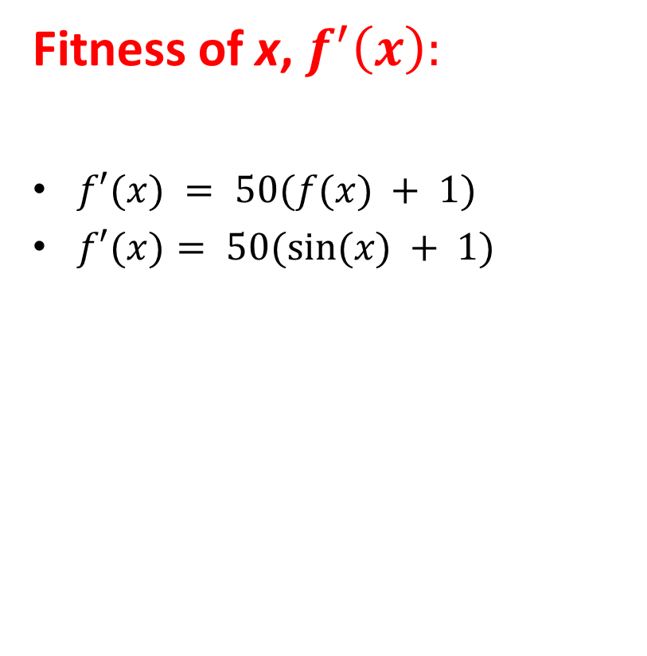
Fitness Function (Optimization)
x | f(x)=sin(x) | f'(x) = 50(f(x)+1)
0
1
2
3
4
5
6
7
8
9
10
11
12
13
14
15
Fitness of x, $f^{′}\left(x\right):$
$f′(x) = 50(f(x) + 1)$
$f′(x)= 50(sin⁡(x) + 1)$

Slide 23
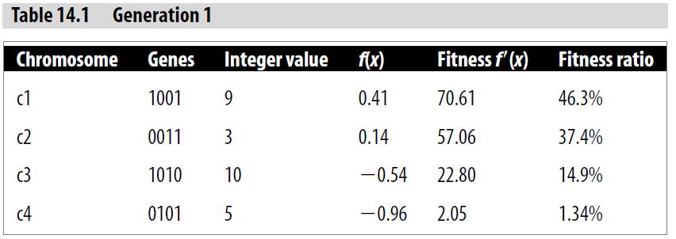
Fitness Function (Optimization)
The range of real numbers from 0 to 100 is divided up between the chromosomes proportionally to each chromosome’s fitness.
In first generation:
  c1 has 46.3% of the range (i.e., from 0 to 46.3)
  c2 37.4% of the range (i.e., from 46.4 to 83.7)
  ….

Slide 24
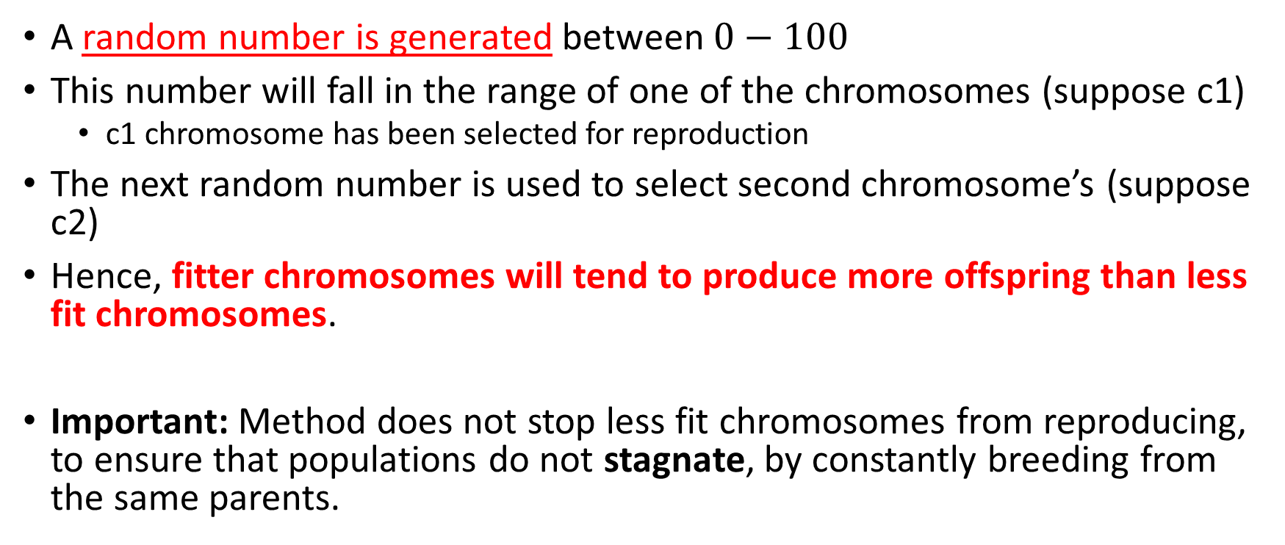
Roulette-wheel selection
A random number is generated between $0−100$
This number will fall in the range of one of the chromosomes (suppose c1)
  c1 chromosome has been selected for reproduction
The next random number is used to select second chromosome’s (suppose c2)
Hence, fitter chromosomes will tend to produce more offspring than less fit chromosomes.
Important: Method does not stop less fit chromosomes from reproducing, to ensure that populations do not stagnate, by constantly breeding from the same parents.

Slide 25
Next Generation
Need 4 random numbers for next generation
Assume that:
First random number is 56.7 (c2 is chosen)
Second random number is 38.2 (c1 is chosen)
Third random number is 20 (c1 is chosen)
Fourth random number is 85 (c3 is chosen)

Slide 26
Next Generation cont.
Combine first two to produce two new offspring:
  Crossover point
Combine last two to produce two new offspring:
  Crossover point
c1 = 1001 (9) | c2 = 0011 (3)
c5 = 1011 (11) | c6 = 0001 (1)




c1 = 1001 (9) | c3 = 1010 (10)
c8 = 1011 (11) | c7 = 1000 (8)





Slide 27
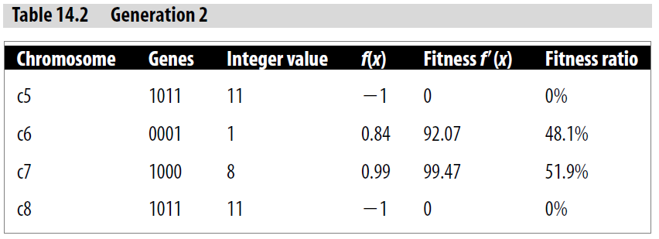
Second generation: c5 to c8
c4 did not have a chance to reproduce (its genes will be lost)
Fittest chromosome in the first generation (c1), able to reproduce twice
Passing on its highly fit genes to all members of the next generation
Extremely fit

Slide 28
Termination criteria
Termination criteria would probably determine that c7 is the most fit (local optimum) and the algorithm will be stopped.

Slide 29
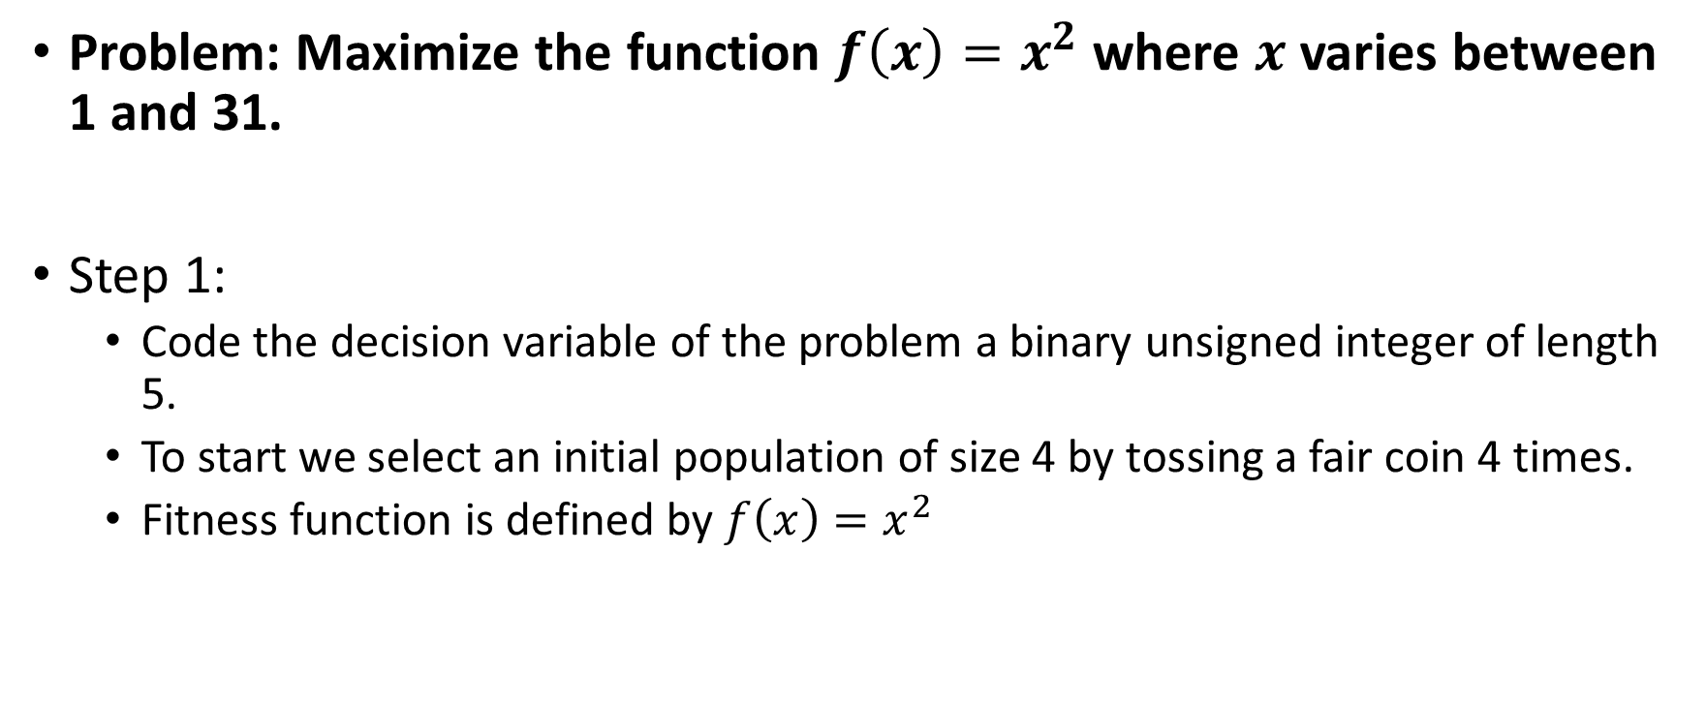

Example: $f\left(x\right)=x^{2}$
Problem: Maximize the function $f\left(x\right)=x^{2}$ where $x$ varies between 1 and 31.
Step 1:
  Code the decision variable of the problem a binary unsigned integer of length 5.
  To start we select an initial population of size 4 by tossing a fair coin 4 times.
  Fitness function is defined by $f\left(x\right)=x^{2}$

Slide 30
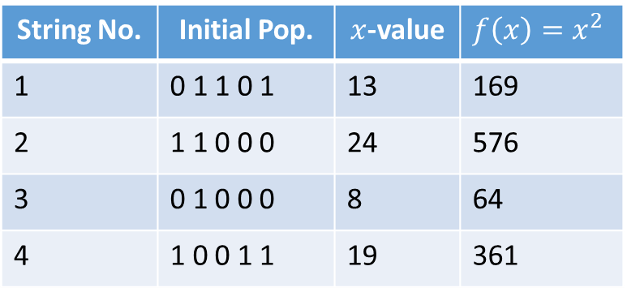
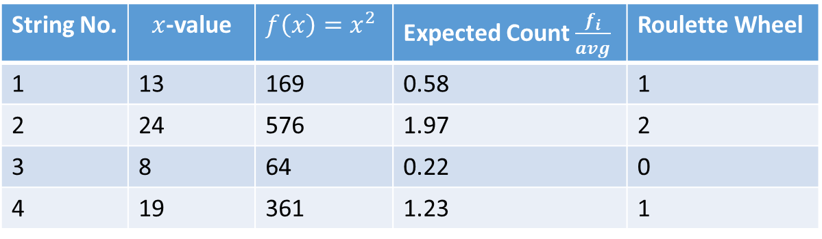
Example: $f\left(x\right)=x^{2}$
String No. | Initial Pop. | $x$-value | $$f\left(x\right)=x^{2}$$
1 | 0 1 1 0 1 | 13 | 169
2 | 1 1 0 0 0 | 24 | 576
3 | 0 1 0 0 0 | 8 | 64
4 | 1 0 0 1 1 | 19 | 361
String No. | $x$-value | $$f\left(x\right)=x^{2}$$ | Expected Count $\frac{f_{i}}{avg}$ | Roulette Wheel
1 | 13 | 169 | 0.58 | 1
2 | 24 | 576 | 1.97 | 2
3 | 8 | 64 | 0.22 | 0
4 | 19 | 361 | 1.23 | 1

Slide 31
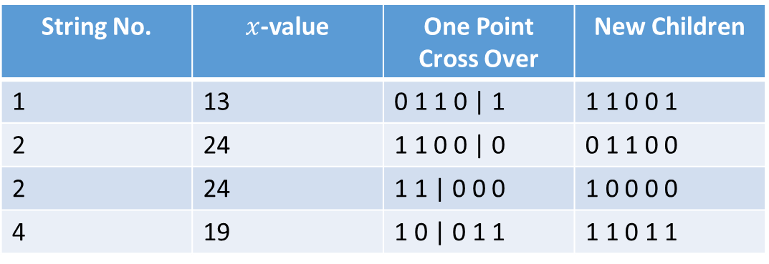
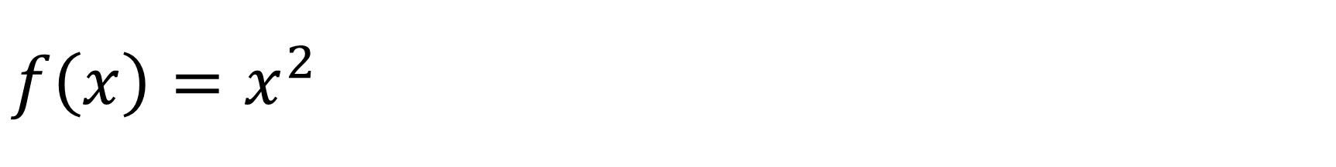
$$f\left(x\right)=x^{2}$$
The best strings get more copies, while the weak ones just die off.
After selection, crossover takes place
  Strings combined randomly using one point cross over
  Apply one bit mutation
String No. | $x$-value | One Point Cross Over | New Children
1 | 13 | 0 1 1 0 | 1 | 1 1 0 0 1
2 | 24 | 1 1 0 0 | 0 | 0 1 1 0 0
2 | 24 | 1 1 | 0 0 0 | 1 0 0 0 0
4 | 19 | 1 0 | 0 1 1 | 1 1 0 1 1
Apply Mutation | New Population
1 1 0 0 1 | 1 1 1 0 1
0 1 1 0 0 | 0 1 1 0 1
1 0 0 0 0 | 1 0 1 0 0
1 1 0 1 1 | 1 1 0 0 1

Slide 32
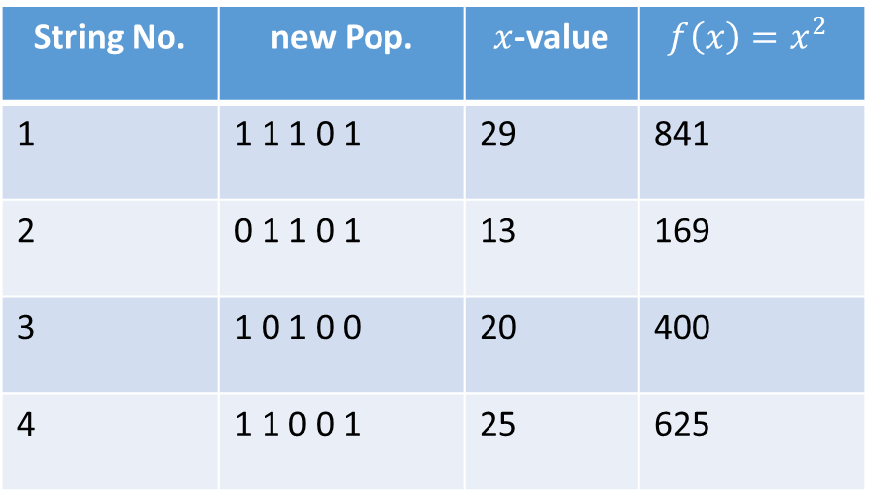
$$f\left(x\right)=x^{2}$$
New Population
String No. | new Pop. | $x$-value | $$f\left(x\right)=x^{2}$$
1 | 1 1 1 0 1 | 29 | 841
2 | 0 1 1 0 1 | 13 | 169
3 | 1 0 1 0 0 | 20 | 400
4 | 1 1 0 0 1 | 25 | 625

Slide 33
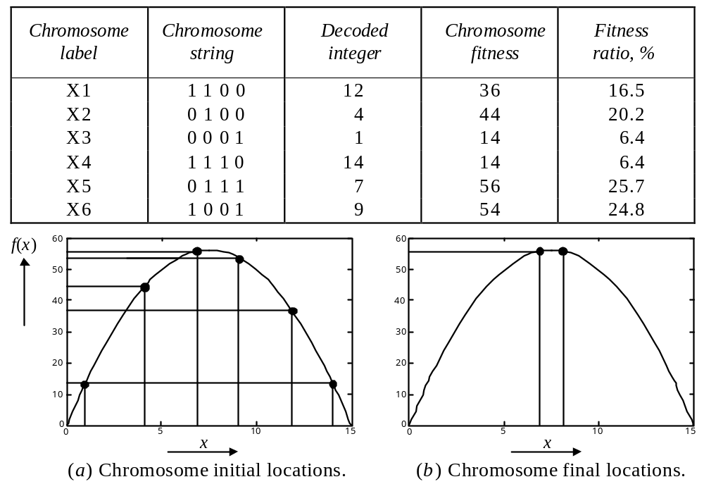
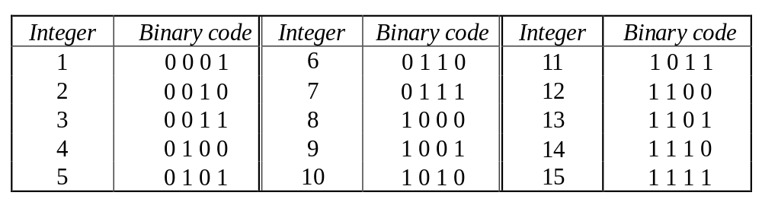
Practice Question
Find the maximum value of function
  f(x) = –x² + 15x
  Represent problem using chromosomes built from four genes:
  Initial random population of size N = 6:

Slide 34
Practice Question
Determine chromosome fitness for each chromosome:

Slide 35
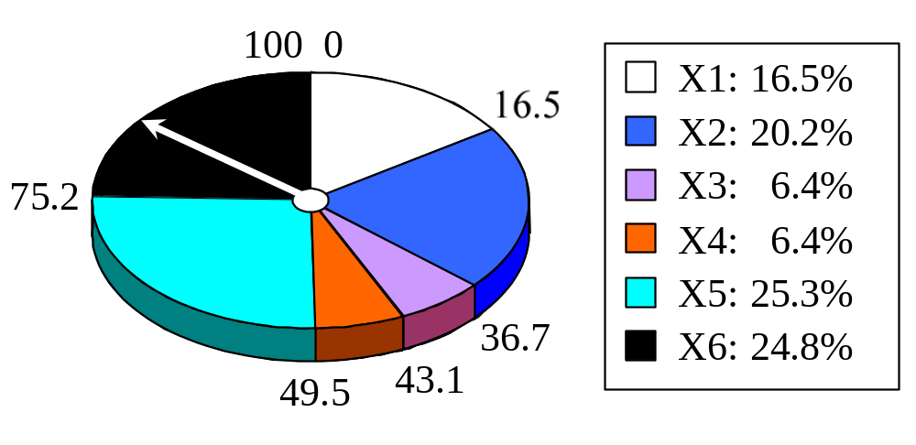
Practice Question
Use fitness ratios to determine which chromosomes are selected for crossover and mutation operations:

Slide 36
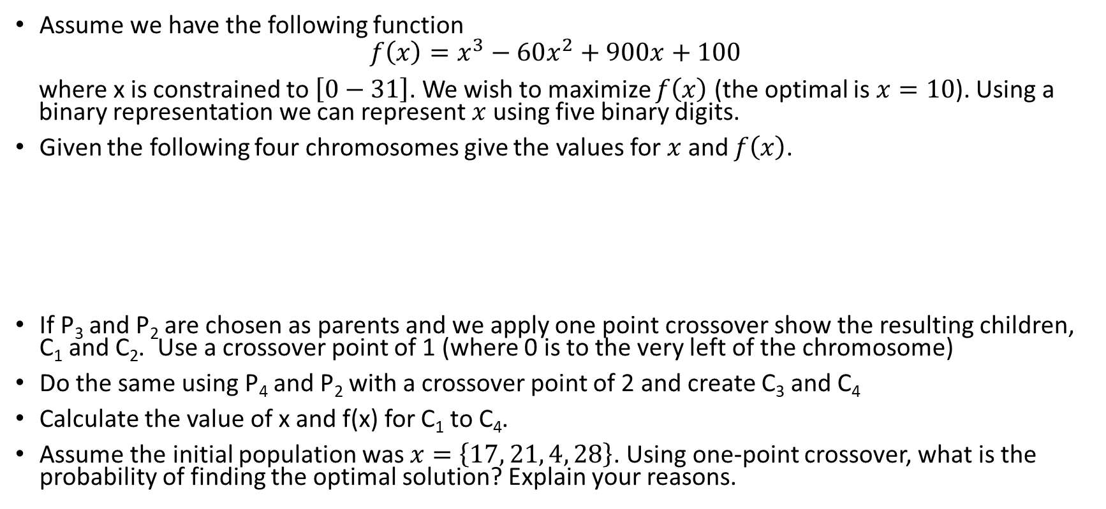
Practice Question
Assume we have the following function
$$f\left(x\right)=x^{3}−60x^{2}+900x+100$$
where x is constrained to $\left[0−31\right]$. We wish to maximize $f\left(x\right)$ (the optimal is $x=10$). Using a binary representation we can represent $x$ using five binary digits.
Given the following four chromosomes give the values for $x$ and $f\left(x\right)$.
If P₃ and P₂ are chosen as parents and we apply one point crossover show the resulting children, C₁ and C₂. Use a crossover point of 1 (where 0 is to the very left of the chromosome)
Do the same using P₄ and P₂ with a crossover point of 2 and create C₃ and C₄
Calculate the value of x and f(x) for C₁ to C₄.
Assume the initial population was $x=\left\{17, 21, 4, 28\right\}$. Using one-point crossover, what is the probability of finding the optimal solution? Explain your reasons.
Chromosome | Binary String
P₁ | 11100
P₂ | 01111
P₃ | 10111
P₄ | 00100

Slide 37
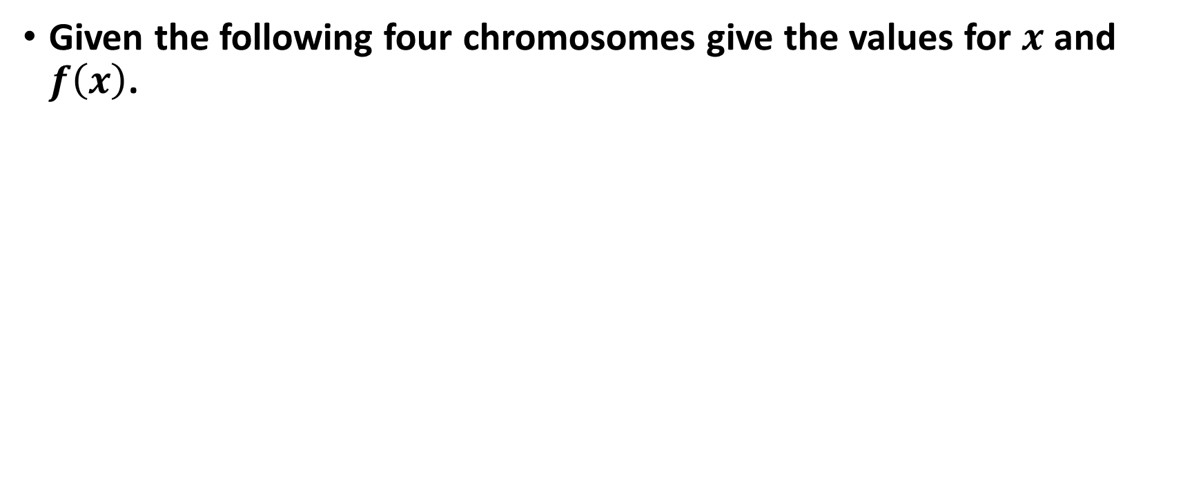
Practice Question – SOLUTION
Given the following four chromosomes give the values for $x$ and $f\left(x\right)$.
Chromosome | Binary String | x | f(x)
P₁ | 11100 | 28 | 212
P₂ | 01111 | 15 | 3475
P₃ | 10111 | 23 | 1227
P₄ | 00100 | 4 | 2804

Slide 38
Practice Question – SOLUTION
If P₃ and P₂ are chosen as parents and we apply one point crossover show the resulting children, C₁ and C₂. Use a crossover point of 1 (where 0 is to the very left of the chromosome)
Calculate the value of x and f(x) for C₁ to C₄.
Chromosome | Binary String | x | f(x)
C₁ | 11111 | 31 | 131
C₂ | 00111 | 7 | 3803
C₃ | 00111 | 7 | 3803
C₄ | 01100 | 12 | 3998

Slide 39
GA Example - Crossover
P₃
1
0
1
1
1
P₄
0
0
1
0
0
P₂
0
1
1
1
1
P₂
0
1
1
1
1
C₁
1
1
1
1
1
C₃
0
0
1
1
1
C₂
0
0
1
1
1
C₄
0
1
1
0
0

Slide 40
GA Example - After First Round of Breeding
The average evaluation has risen P₂, was the strongest individual in the initial population. It was chosen both times but we have lost it from the current population
We have a value of x=7 in the population which is the closest value to 10 we have found
Chromosome | Binary String | x | f(x)
P₁ | 11111 | 31 | 131
P₂ | 00111 | 7 | 3803
P₃ | 00111 | 7 | 3803
P₄ | 01100 | 12 | 3998
 | TOTAL |  | 11735
 | AVERAGE |  | 2933.75

